Slide 1

CERTIFICATE III IN AUTOMOTIVE REPAIR & MAINTENANCE
SUBJECT: VEHICLE MAINTENACE AND REPAIR
By Ibrahim siraj
Maldives polytechnic

Slide 2
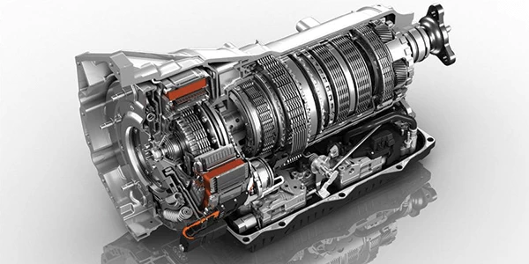
VEHICLE MAINTENACE AND REPAIR
Chapter 11 Inspection and Service Automatize Transmission
Introduction
An automatic transmission (AT) is a vehicle gearbox that automatically changes gear ratios as the vehicle moves, without requiring the driver to manually operate a clutch or shift gears. This results in a simpler and more comfortable driving experience, especially in heavy traffic
By Ibrahim siraj
Maldives polytechnic

Slide 3
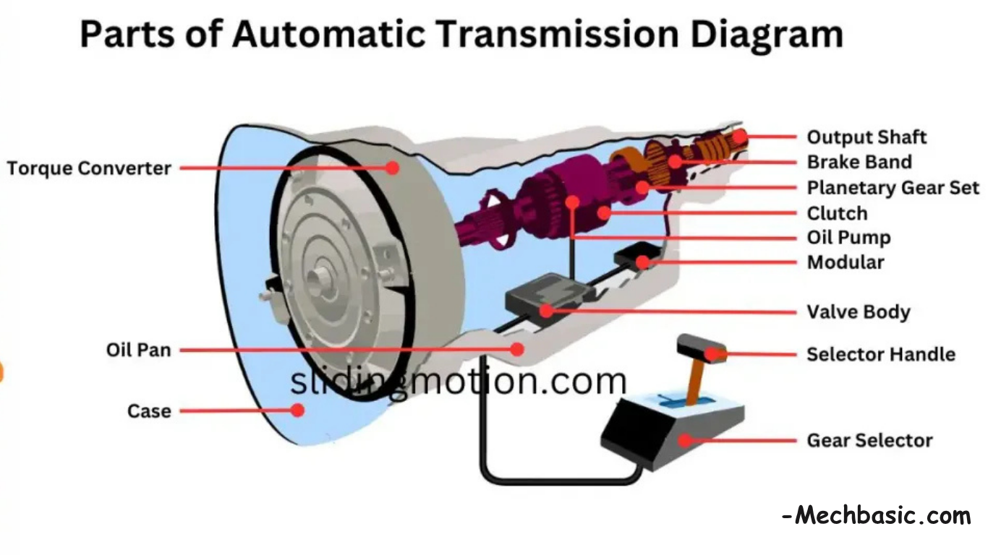
VEHICLE MAINTENACE AND REPAIR
Chapter 11 Inspection and Service Automatize Transmission
How Automatic Transmission Works
An automatic transmission works by automatically changing gear ratios based on vehicle speed, engine load, and throttle position, eliminating the need for a manual clutch pedal or gear shifter. It achieves this through a combination of fluid dynamics, mechanical gear sets, and hydraulic controls
1 Torque Converter
2 Planetary Gear sets
3 Hydraulic System and Valve Body
4 Electronic Unit (ECU) / Transmission Control Unit (TCU)
By Ibrahim siraj
Maldives polytechnic

Slide 4
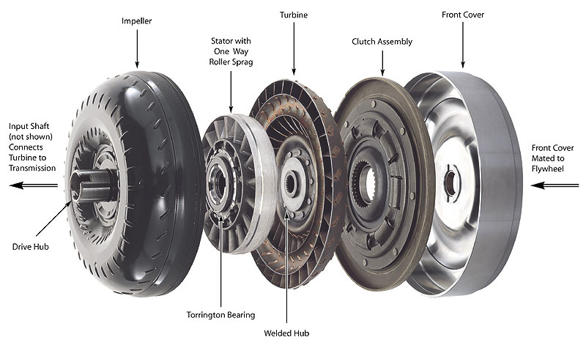
VEHICLE MAINTENACE AND REPAIR
Chapter 11 Inspection and Service Automatize Transmission
How Automatic Transmission Works
1 Torque Converter
A fluid-filled coupling component that replaces the manual clutch. It relies on an impeller, turbine, and stator to hydraulically transfer power from the engine to the transmission, allowing the vehicle to idle without stalling
By Ibrahim siraj
Maldives polytechnic

Slide 5
VEHICLE MAINTENACE AND REPAIR
Chapter 11 Inspection and Service Automatize Transmission
How Automatic Transmission Works
1 Torque Converter
How a Torque Converter Works
Impeller (Pump): Spun directly by the engine, it throws transmission fluid outwards via centrifugal force.
Turbine: Receives the fluid from the impeller, causing it to spin and transfer power to the transmission input shaft.
Stator: Located between the impeller and turbine, it redirects fluid returning from the turbine, reducing energy loss and multiplying torque.
By Ibrahim siraj
Maldives polytechnic

Slide 6
VEHICLE MAINTENACE AND REPAIR
Chapter 11 Inspection and Service Automatize Transmission
How Automatic Transmission Works
1 Torque Converter
Key Characteristics and Benefits
Smooth Operation: By using fluid to transmit power rather than a direct mechanical connection, it offers extremely smooth take-offs and gear shifts.
Torque Multiplication: It multiplies engine torque during acceleration, enhancing starting power.
Reliability: Known for being durable and dependable compared to other automated manual systems.
Lockup Clutch: Modern torque converters include a lockup clutch that creates a direct mechanical connection at higher speeds to improve fuel efficiency
By Ibrahim siraj
Maldives polytechnic

Slide 7
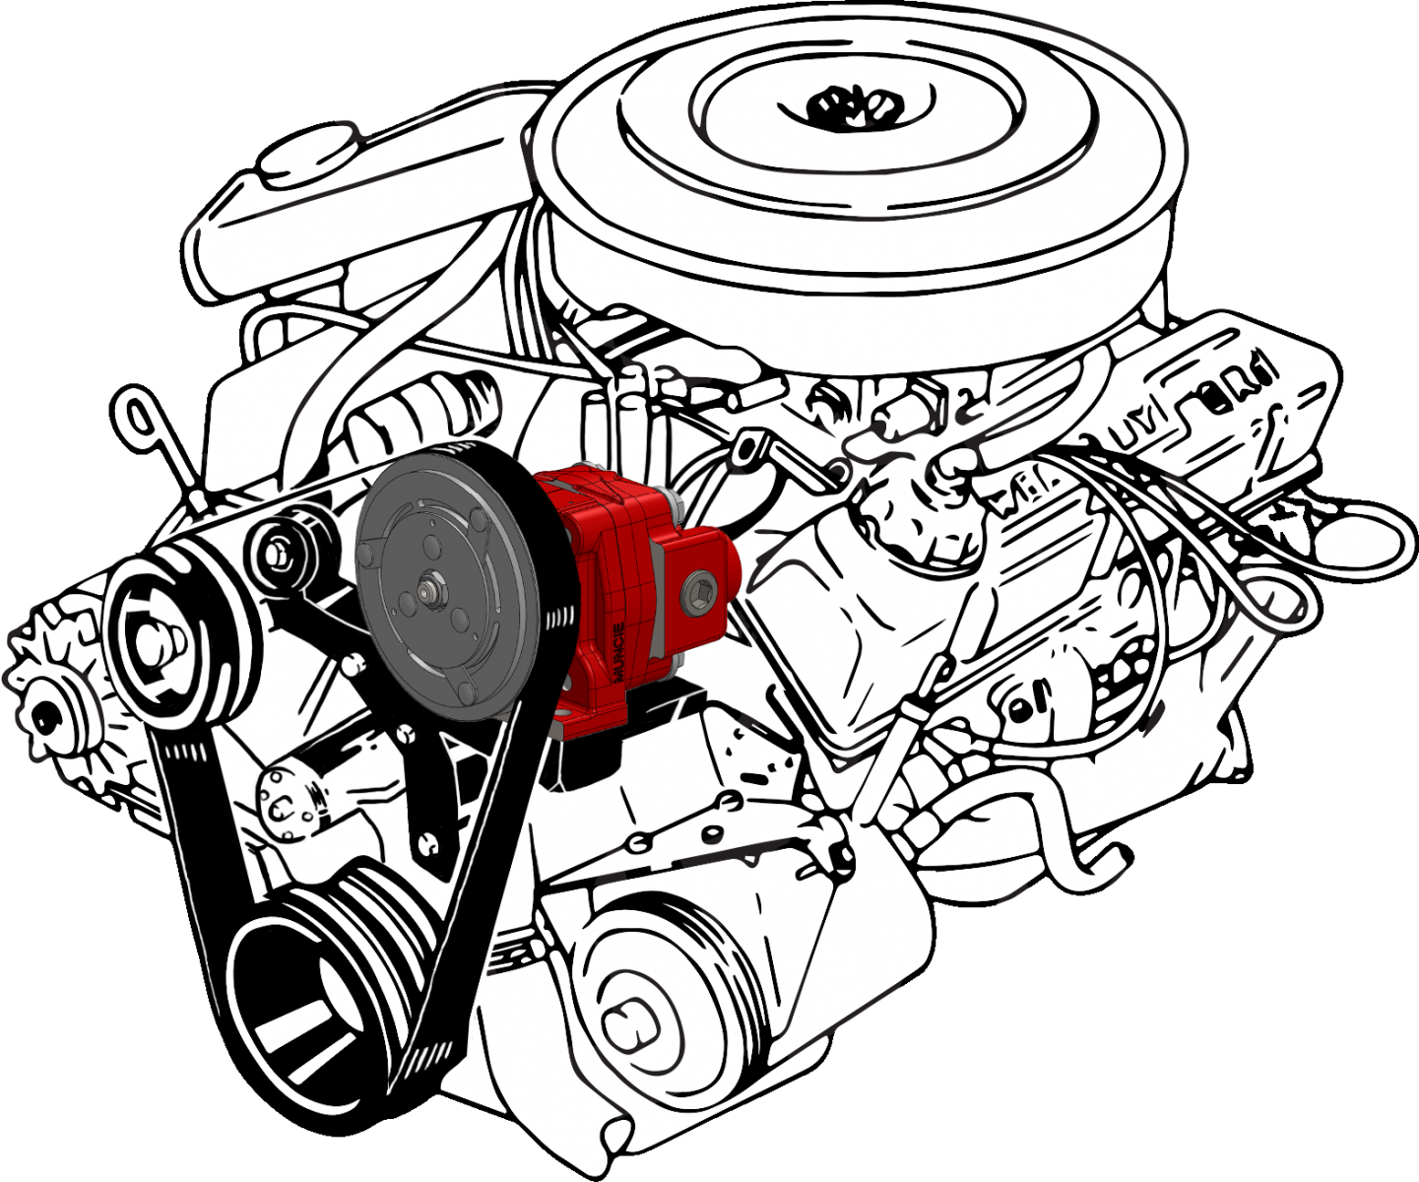
VEHICLE MAINTENACE AND REPAIR
Chapter 11 Inspection and Service Automatize Transmission
How Automatic Transmission Works
Transmission Pump
Transmission pumps are essential components of automatic transmissions that generate hydraulic pressure to circulate transmission fluid, lubricate moving parts, cool the system, and operate clutch packs. A "clutch pump," in the context of hydraulics, is typically a small, belt-driven gear pump used on trucks to provide auxiliary hydraulic power, whereas the hydraulic pressure within a transmission for engaging clutches is usually provided by the main internal oil pump.
Types of Transmission Pumps (Internal)
Gear Pumps (Crescent Type): A common type consisting of a smaller, inner drive gear and a larger, outer driven gear with a crescent-shaped separator.
Vane Pumps: Utilize a rotor and vanes that create chambers which expand and contract to draw in and pressurize the Automatic Transmission Fluid (ATF).
Gerotor Pumps: Use inner and outer rotors to create pressure, often used for their compact design.
By Ibrahim siraj
Maldives polytechnic

Slide 8
VEHICLE MAINTENACE AND REPAIR
Chapter 11 Inspection and Service Automatize Transmission
How Automatic Transmission Works
Function of the Transmission Pump
Main Pressure Generation: Creates the hydraulic pressure required for shifting gears smoothly and keeping bands and clutches engaged, preventing slippage.
Torque Converter Filling: Ensures the torque converter remains full of fluid to transfer power.
Cooling and Lubrication: Circulates ATF through the cooler to prevent overheating and oils the gears and moving parts.
Shift Timing: Supplies the necessary pressure to the valve body, which acts as the control center for changing gears.
By Ibrahim siraj
Maldives polytechnic

Slide 9
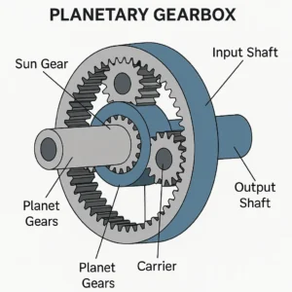
VEHICLE MAINTENACE AND REPAIR
Chapter 11 Inspection and Service Automatize Transmission
How Automatic Transmission Works
Planetary Gearsets: These are a complex arrangement of gears that provide various gear ratios. They are responsible for changing the speed and torque output from the engine to the wheels
compact, efficient mechanical systems that use a central sun gear, orbiting planet gears within an outer ring gear, and a carrier to transmit high torque and control speed in applications like automatic transmissions, robotics, and industrial machinery.
By Ibrahim siraj
Maldives polytechnic

Slide 10
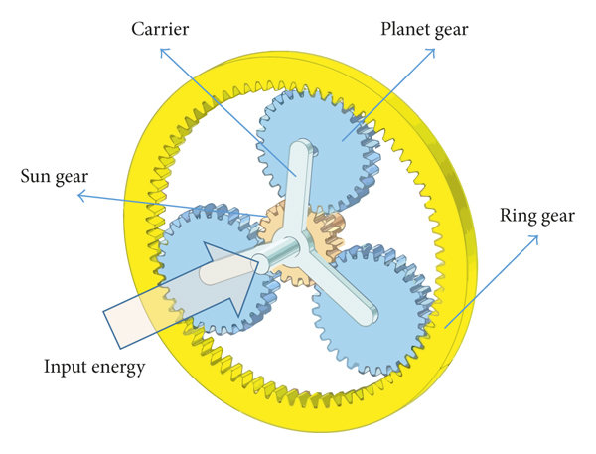
VEHICLE MAINTENACE AND REPAIR
Chapter 11 Inspection and Service Automatize Transmission
How Automatic Transmission Works
Planetary Gearsets
Sun Gear: Located at the center, this gear receives the input power and transmits torque to the planet gears.
Planet Gears: Typically three or more gears that mesh with the sun gear and the outer ring gear. They are mounted on a carrier and orbit around the sun gear while rotating on their own axes.
Ring Gear: An outer gear with internal teeth that meshes with the planet gears.
Carrier: This component holds the planet gears in place and their spacing, often serving as the output shaft
By Ibrahim siraj
Maldives polytechnic

Slide 11
VEHICLE MAINTENACE AND REPAIR
Chapter 11 Inspection and Service Automatize Transmission
Planetary Gear sets
A planetary gear set, also known as an epicyclic gear train, is a gear arrangement that resembles the solar system, providing high torque and speed reduction within a compact design
How It Works
The versatility of a planetary gear set comes from the ability to hold one of its three main components (sun gear, ring gear, or carrier) stationary while using the other two for power input and output, thereby achieving different gear ratios and directions.
Common configurations include
Speed Reduction (Forward): If the ring gear is held stationary and the sun gear is the input, the planet carrier becomes the output, resulting in a large torque increase and speed reduction
Overdrive (Forward): If the sun gear is held stationary and the carrier is the input, the ring gear becomes the output, resulting in the output turning faster than the input
Reverse: If the carrier is held stationary, input is applied to the sun gear, and output is taken from the ring gear (or vice versa), the direction of rotation is reversed.
By Ibrahim siraj
Maldives polytechnic

Slide 12
VEHICLE MAINTENACE AND REPAIR
Chapter 11 Inspection and Service Automatize Transmission
Hydraulic System and Valve Body
The hydraulic system and valve body in an automotive gearbox work together to control gear shifts by using pressurized automatic transmission fluid (ATF) to engage and disengage internal clutches and bands. The valve body acts as the "brain" of the transmission, directing this fluid through a maze of channels based on driving conditions
The Hydraulic System
Transmission Fluid (ATF): A specialized fluid that is not compressible, allowing it to transfer pressure effectively throughout the system, as well as providing lubrication and heat dissipation.
Oil Pump: Driven by the engine via the torque converter, the pump generates the necessary high-pressure fluid whenever the engine is running.
Actuators: These include pistons and servos that convert the hydraulic pressure into mechanical force to apply clutches and bands, which in turn lock or unlock different parts of the planetary gear sets to achieve various gear ratios.
Reservoir/Pan: The transmission oil pan acts as a sump to store the ATF, allowing air bubbles to dissipate and contaminants to settle, with a filter to clean the fluid before it goes to the pump
By Ibrahim siraj
Maldives polytechnic

Slide 13
VEHICLE MAINTENACE AND REPAIR
Chapter 11 Inspection and Service Automatize Transmission
The Valve Body
The valve body is an intricate control center made of a complex network of passages, valves, springs, and, in modern systems, solenoids.
Manual Valve: Directly connected to the driver's gear selector, this valve directs fluid to the specific hydraulic circuits required for the chosen gear range (e.g., Park, Reverse, Neutral, Drive).
Shift Valves: These spool valves are balanced by various pressures (e.g., governor pressure, modulator pressure/throttle position) and spring tension. They move within their bores to open and close passages, directing fluid to the appropriate clutch packs or bands to execute automatic upshifts and downshifts based on vehicle speed and engine load.
Solenoids: In modern, electronically controlled transmissions, solenoids are mounted in the valve body and controlled by a Transmission Control Unit (TCU) or Engine Control Unit (ECU). They receive electronic signals and precisely regulate the fluid pressure and direction to the appropriate components, allowing for more refined control over shift points and quality.
Pressure Regulating Valves: These components, along with a pressure relief valve, ensure that the hydraulic pressure in the system is maintained within the optimal range and is sufficient for all operations without causing damage
By Ibrahim siraj
Maldives polytechnic

Slide 14
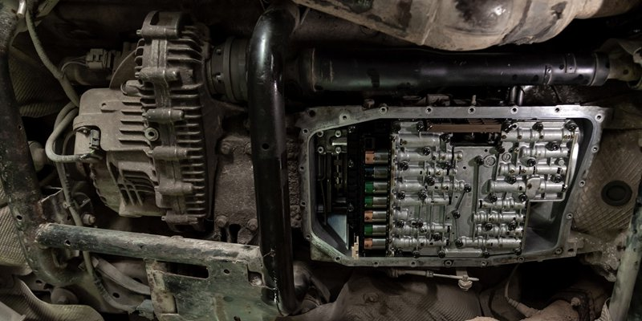
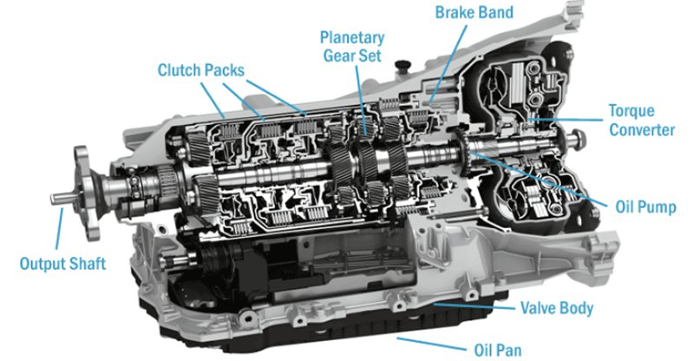
VEHICLE MAINTENACE AND REPAIR
Chapter 11 Inspection and Service Automatize Transmission
The Valve Body
By Ibrahim siraj
Maldives polytechnic

Slide 15
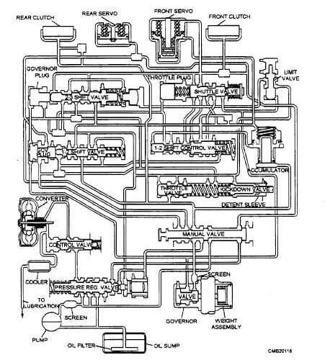
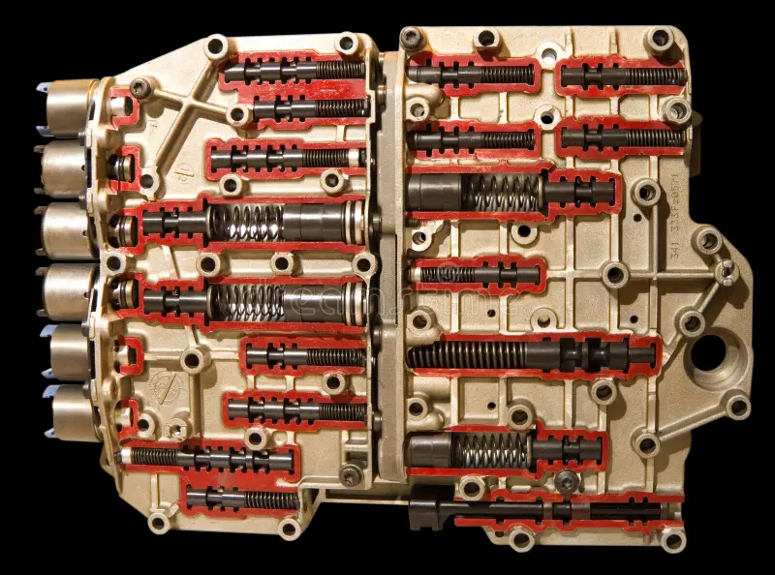
VEHICLE MAINTENACE AND REPAIR
Chapter 11 Inspection and Service Automatize Transmission
The Valve Body
By Ibrahim siraj
Maldives polytechnic

Slide 16
VEHICLE MAINTENACE AND REPAIR
Chapter 11 Inspection and Service Automatize Transmission
Electronic Unit (ECU) / Transmission Control Unit (TCU)
In automotive engineering, ECU stands for Electronic Control Unit, a generic term for any embedded system that manages one or more of the vehicle's electrical systems or subsystems. A TCU stands for Transmission Control Unit, which is a specific type of ECU dedicated to managing the automatic transmission.
Key functions of different types of ECUs include
Engine Control Unit (ECU or ECM): Monitors and adjusts engine parameters like fuel injection, ignition timing, and emissions control
Transmission Control Unit (TCU or TCM): Manages gear shifting in automatic or semi-automatic transmissions
Brake Control Module (BCM): Governs the anti-lock braking system (ABS) and electronic stability control (ESC).
Body Control Module (BBM): Controls convenience functions such as power windows, central locking, and interior lighting.
By Ibrahim siraj
Maldives polytechnic

Slide 17
VEHICLE MAINTENACE AND REPAIR
Chapter 11 Inspection and Service Automatize Transmission
Electronic Unit (ECU) / Transmission Control Unit (TCU)
Transmission Control Unit (TCU)
The TCU is a specialized computer for automatic and semi-automatic transmissions. It ensures smooth and efficient gear shifts based on real-time data from various sensors
How it works
Inputs: The TCU receives information from sensors measuring vehicle speed, engine speed (RPM), throttle position, transmission fluid temperature and pressure, and requested gear mode.
Processing: It processes this data using internal software and algorithms to determine when and how to change gears for the best balance of performance, fuel economy, and shift quality. Modern TCUs can even adapt to a driver's style through adaptive learning.
Outputs: The TCU sends commands to actuators like shift solenoids and pressure control solenoids, which manage the hydraulic pressure to engage or disengage clutches and bands to select the correct gear. It also communicates with the engine ECU to momentarily reduce engine torque during shifts for smoothness.
By Ibrahim siraj
Maldives polytechnic

Slide 18
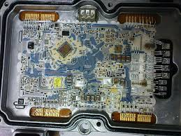
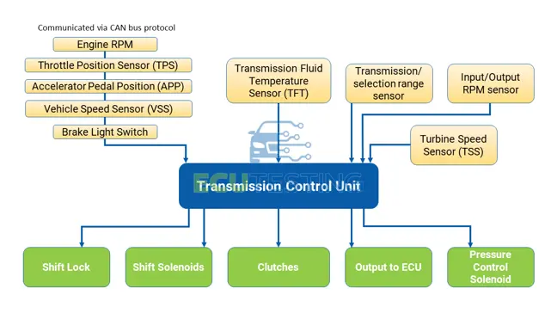
VEHICLE MAINTENACE AND REPAIR
Chapter 11 Inspection and Service Automatize Transmission
Electronic Unit (ECU) / Transmission Control Unit (TCU)
By Ibrahim siraj
Maldives polytechnic

Slide 19
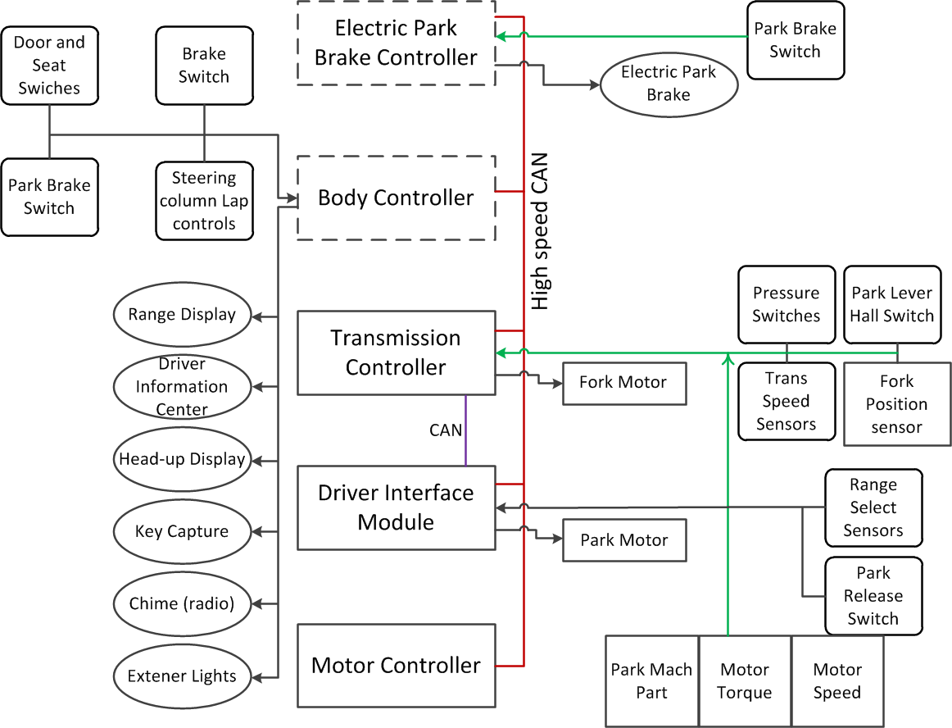
VEHICLE MAINTENACE AND REPAIR
Chapter 11 Inspection and Service Automatize Transmission
Electronic Unit (ECU) / Transmission Control Unit (TCU)
By Ibrahim siraj
Maldives polytechnic

Slide 20
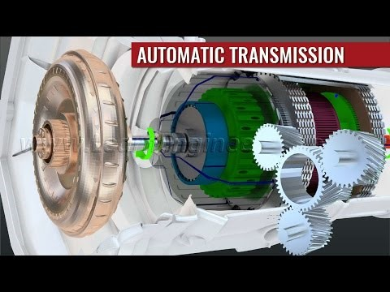
VEHICLE MAINTENACE AND REPAIR
Chapter 11 Inspection and Service Automatize Transmission
Electronic Unit (ECU) / Transmission Control Unit (TCU)
By Ibrahim siraj
Maldives polytechnic

Slide 21
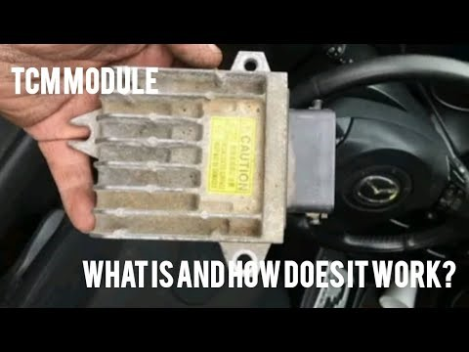
VEHICLE MAINTENACE AND REPAIR
Chapter 11 Inspection and Service Automatize Transmission
Electronic Unit (ECU) / Transmission Control Unit (TCU)
By Ibrahim siraj
Maldives polytechnic

Slide 22
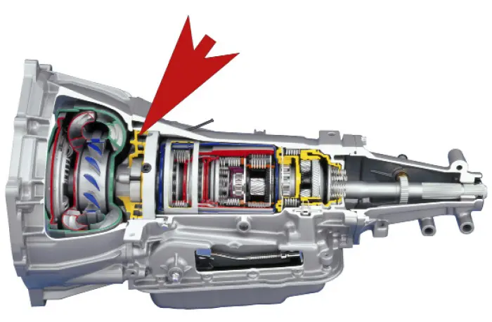
VEHICLE MAINTENACE AND REPAIR
Chapter 11 Inspection and Service Automatize Transmission
Automatic Transmission Fluid (ATF) works
Automatic Transmission Fluid (ATF) works as the literal lifeblood of an automatic transmission, functioning simultaneously as a hydraulic fluid to shift gears, a hydrodynamic fluid to transfer engine power, a coolant, and a specialized lubricant. Unlike standard motor oil which only lubricates, ATF is highly pressurized and physically drives the mechanical actions inside the gearbox.
By Ibrahim siraj
Maldives polytechnic

Slide 23
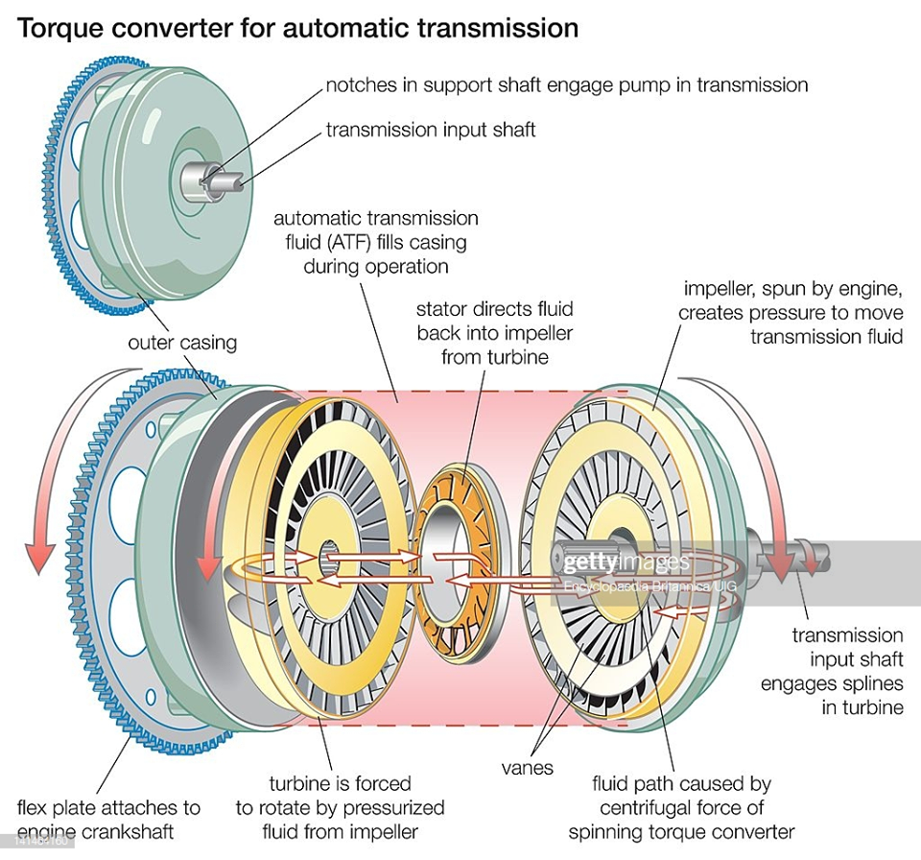
VEHICLE MAINTENACE AND REPAIR
Chapter 11 Inspection and Service Automatize Transmission
Automatic Transmission Fluid (ATF) works
1. Actively Transmitting Engine Power (Hydrodynamics)
ATF acts as the physical medium that connects the engine to the transmission inside the torque converter
The Process: The engine spins an internal pump (impeller), which flings ATF outward using centrifugal force.
The Action: This high-velocity fluid slams into the blades of the turbine, forcing the turbine to rotate and transfer mechanical energy down into the gearbox.
The Analogy: It works like one household fan blowing air to force another unplugged fan to spin, but uses dense fluid instead of air to handle immense engine torque.
By Ibrahim siraj
Maldives polytechnic

Slide 24
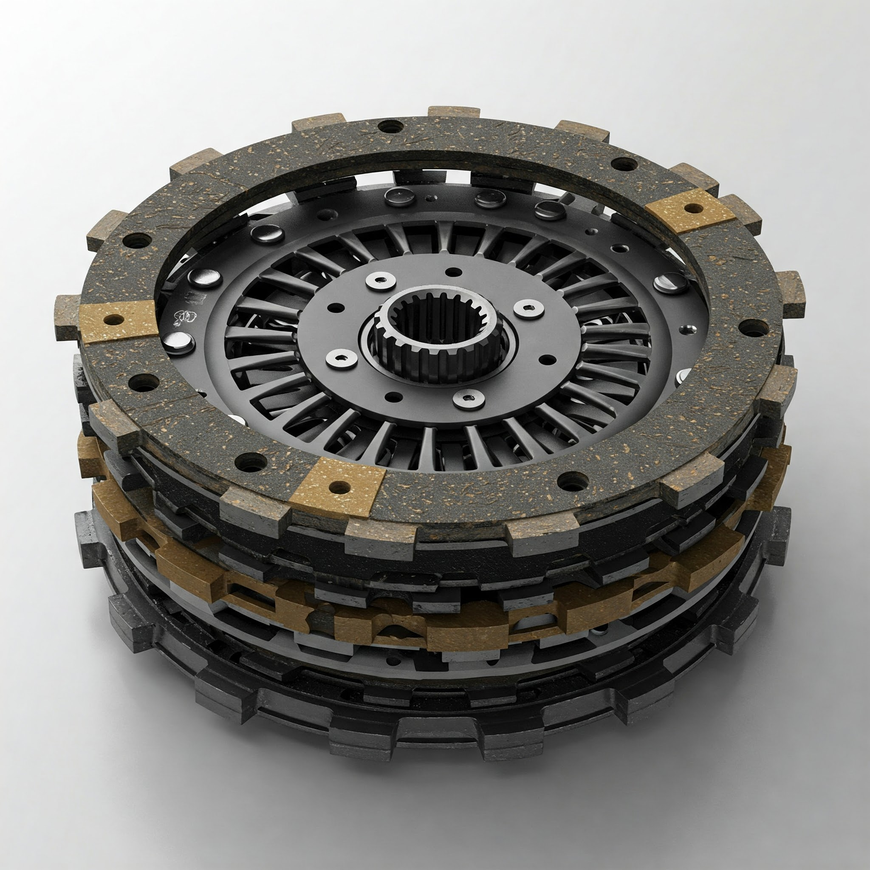
VEHICLE MAINTENACE AND REPAIR
Chapter 11 Inspection and Service Automatize Transmission
Automatic Transmission Fluid (ATF) works
2. Operating the Gear Shifting (Hydraulics)
ATF serves as a high-pressure hydraulic fluid that executes the actual gear changes
The Process: A mechanical oil pump draws ATF from the bottom pan and pressurizes it.
The Action: Driven by computer commands, electronic solenoids open specific channels in the valve body maze. Pressurized ATF rushes down these channels and pushes against heavy-duty hydraulic pistons.
The Result: These pistons squeeze multi-plate clutch packs or tighten friction bands to lock specific planetary gear sets into place, shifting the vehicle's gears
By Ibrahim siraj
Maldives polytechnic

Slide 25
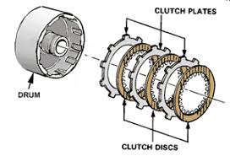
VEHICLE MAINTENACE AND REPAIR
Chapter 11 Inspection and Service Automatize Transmission
Automatic Transmission Fluid (ATF) works
3. Generating Managed Friction (Clutch Performance)
While standard lubricants try to eliminate all friction, ATF contains highly specialized friction modifiers designed to optimize it.
The Process: When clutch packs are compressed by hydraulic fluid to change gears, they must not slip, but they also must not lock up too aggressively, which would cause a violent car jolt.
The Action: ATF is chemically engineered to act as a temporary "glue" under heavy pressure. It provides the exact amount of friction required for the wet clutch plates to grip each other tightly without slipping, ensuring smooth, seamless gear transitions.
By Ibrahim siraj
Maldives polytechnic

Slide 26
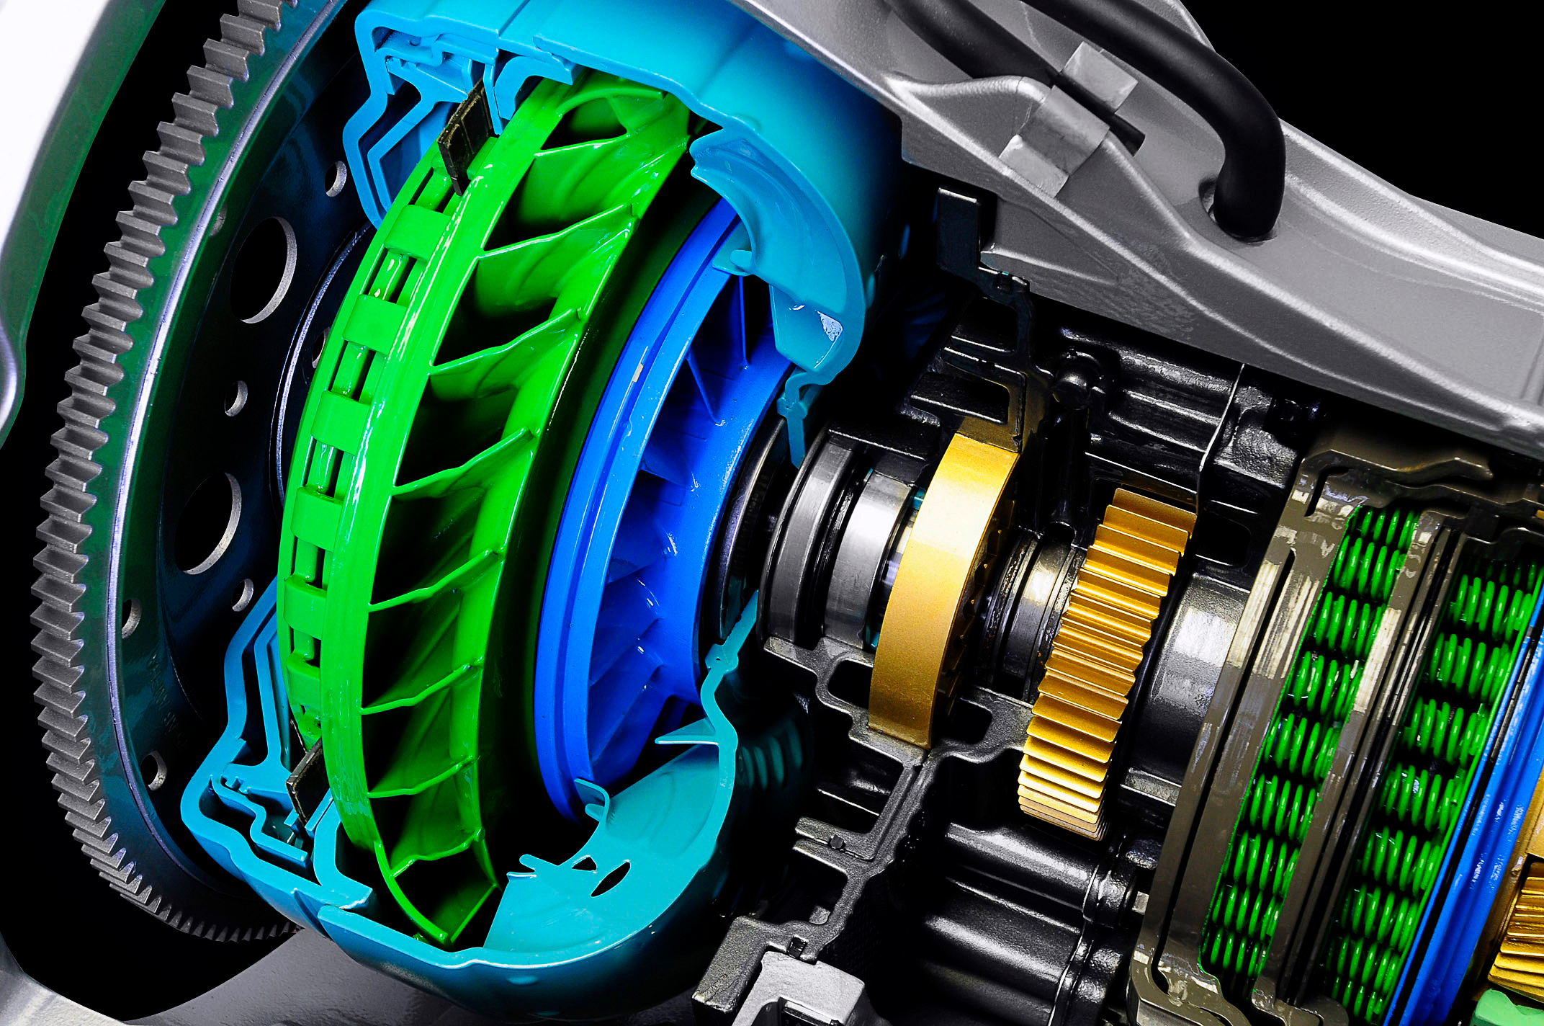
VEHICLE MAINTENACE AND REPAIR
Chapter 11 Inspection and Service Automatize Transmission
Automatic Transmission Fluid (ATF) works
4. Cooling and Lubricating (System Protection)
An automatic transmission creates massive amounts of heat through continuous fluid shearing and clutch friction.
Cooling: ATF continuously flows away from hot gears and the torque converter, moving through external cooling lines to an air or liquid transmission cooler at the front of the vehicle before returning to the pan.
Lubricating: It coats every needle bearing, planetary gear tooth, and spinning shaft with a thin, high-shear film to eliminate metal-to-metal friction and prevent premature wear.
Cleaning: The fluid contains active detergents that trap micro-debris, metal shaving dust, and carbon, carrying them directly to the transmission filter to prevent internal clogs
By Ibrahim siraj
Maldives polytechnic

Slide 27
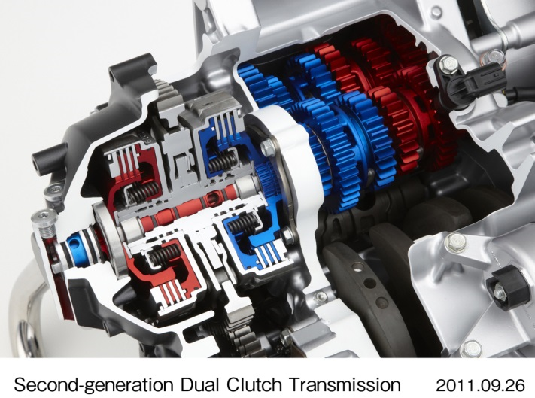
VEHICLE MAINTENACE AND REPAIR
Chapter 11 Inspection and Service Automatize Transmission
Automatic Transmission Fluid (ATF) works
4. Cooling and Lubricating (System Protection)
An automatic transmission creates massive amounts of heat through continuous fluid shearing and clutch friction.
By Ibrahim siraj
Maldives polytechnic

Slide 28
VEHICLE MAINTENACE AND REPAIR
Chapter 11 Inspection and Service Automatize Transmission
Automatic Transmission Fluid (ATF) works
By Ibrahim siraj
Maldives polytechnic

Slide 29
THANK YOU

